Slide 1
Bray Team Week 3 Update
Avery Haynes, Locke Lehmann, Travis Carlson, Cody Sims, Zachary Walker, Michael Hager
2/5/2024

Slide 2
Weekly Deliverables
Tasks | Lead | Percentage Done | Notes
Formulate experimental design for testing | Locke/Avery | 100% | Completed
Peer Evaluation | All | 100% | Completed
Set up sensors in valves/ actuator | Cody/Travis | 30% | First round of supplies arrived, second round to be purchased. Start date TBD by team soon.
Research data analysis methods | Michael | 60% | Have valid research for methods to analyze data with Raspberry Pi.

Slide 3
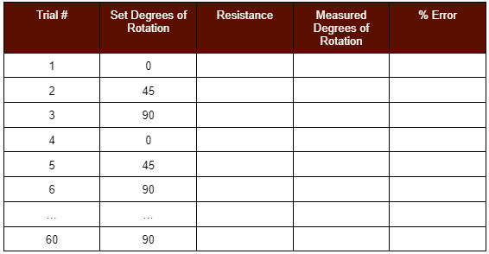
Experimental design: Potentiometer
Hypothesis: Design can achieve below 2% error from the actual rotational position of the ball valve under various temperature conditions.
Independent Variables: Rotational position of the valve, surrounding temperature
Dependent variables: % Error

Slide 4
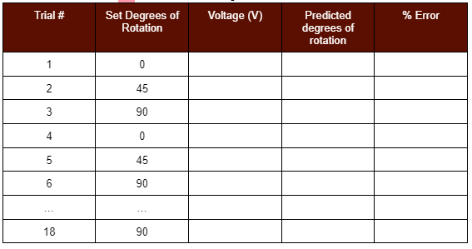
Experimental design: Hall effect sensor
Hypothesis: Design can achieve below 2% error from the actual rotational position of the ball valve/butterfly valve under various temperature conditions.
Independent Variables: Rotational position of the valve, surrounding temperature, distance between hall effect sensor and magnet.
Dependent variables: % Error
Initial distance testing: 0, 2, 4, 6, 8 ,10 mm

Slide 5
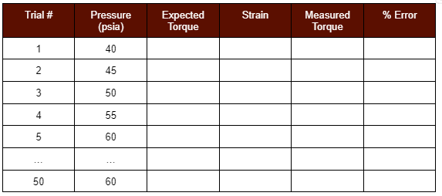
Experimental Design: Bolt Strain Gauge
Hypothesis: Design can achieve below 5% error from the actual torque of the actuator under various temperature and pressure conditions.
Independent variables: Temperature, Pressure
Dependent variables: % error

Slide 6
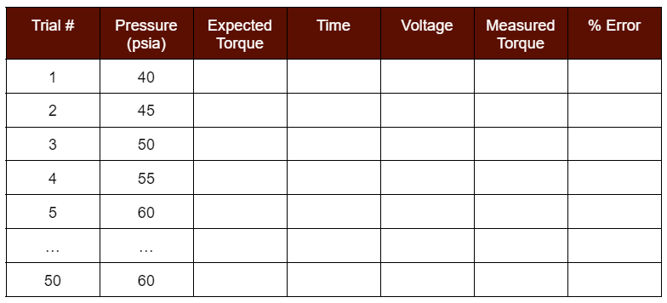
Experimental Design: Motor EMF
Hypothesis: Design can achieve below 5% error from the actual torque of the actuator under various temperature and pressure conditions.
Independent variables: Temperature, Pressure
Dependent variables: % error

Slide 7
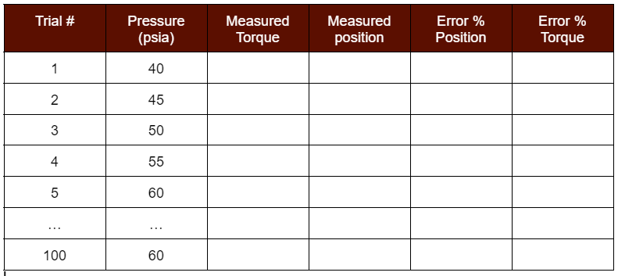
Experimental Design: Combined Concepts
Hypothesis: Design concepts together still achieve the required error percent while under various pressures
Independent variables: pressure
Dependent variables: torque, position, error%
Will Temperature test at room temp, 100℉, and 40℉

Slide 8
Budget/Materials Update
First parts ordered 1/15/24 (arrived, thru much confusion)
For testing position deliverable & collecting data ($128.27)
Asked Bray during today’s call to send materials for:
Activating & toggling actuators
Vice to support valves during testing
Exact hall effect sensor used in their traditional products
Will order supplies for torque deliverables this week
Bolt strain gauges, motor head & belt, additional casing, hall effect sensor

Slide 9
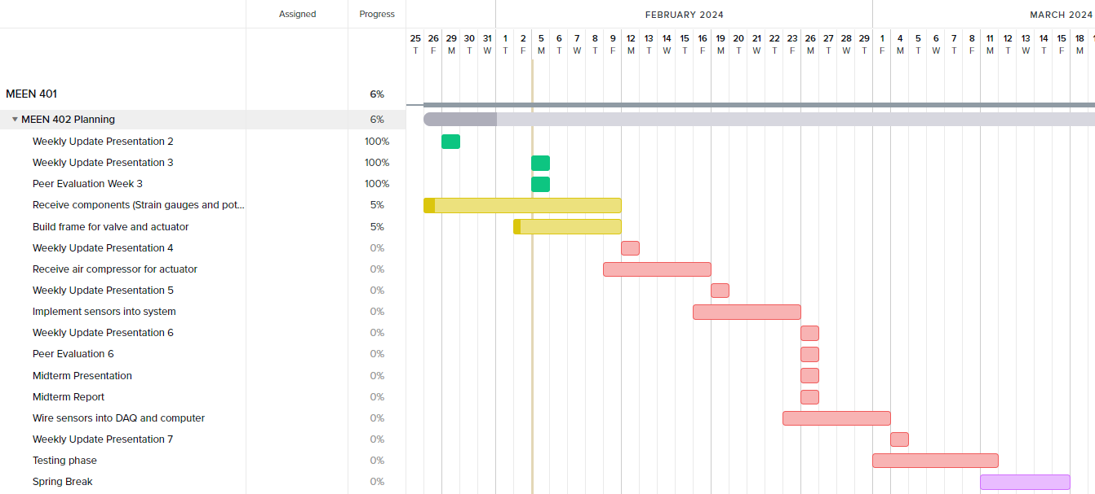
Gantt Chart

Slide 10
Next Week's Deliverables
Tasks | Lead | Percentage Done | Notes
Test sensor setup with valves and actuators | Cody/Travis | 0% | Upon arrival of all supplies, begin system setup and follow test plan.
Build frame for valve and actuator | Zack/Michael | 5% | Start building frame for when parts arrive for testing.
Purchase remaining parts | Avery | 25% | Have talked with Bray, will do a final run through to see if we need to order anything else

